Slide 1
Introduction To PHP

Slide 2
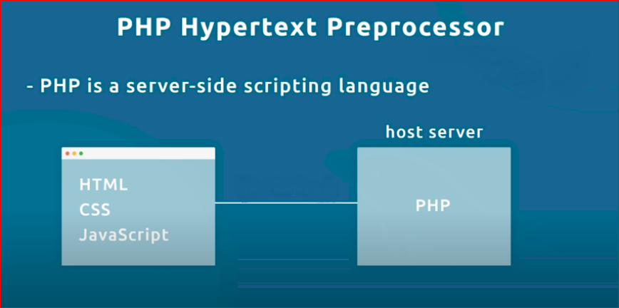

Slide 3
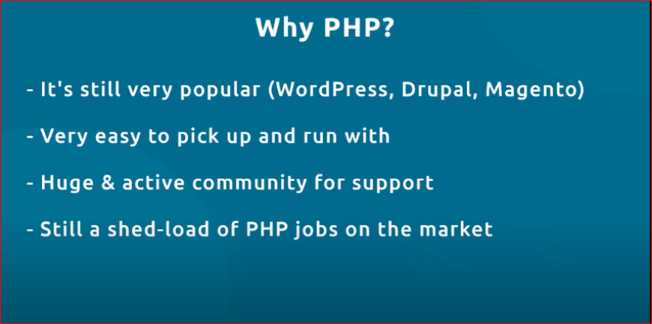

Slide 4
Context:
Installing
PHP basics
Database (sql vs no sql) (new module)
Sql
Rendering Dynamics content to html (back to PHP)
How to connect PHP to mysql database
PHP Forms (CRUD)
Project (New module)
Session cookies api models and other concepts

Slide 5
We will use
2 Layer architecture
Mysqli db connection

Slide 6
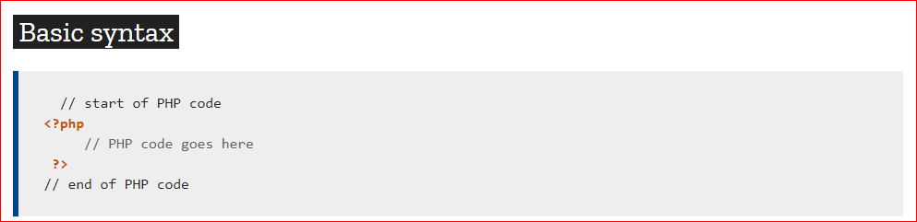

Slide 7
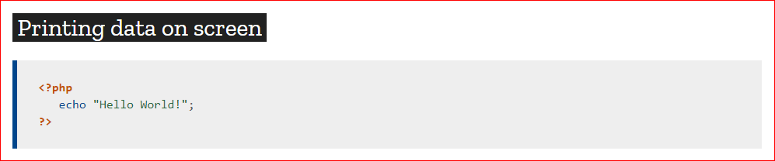

Slide 8
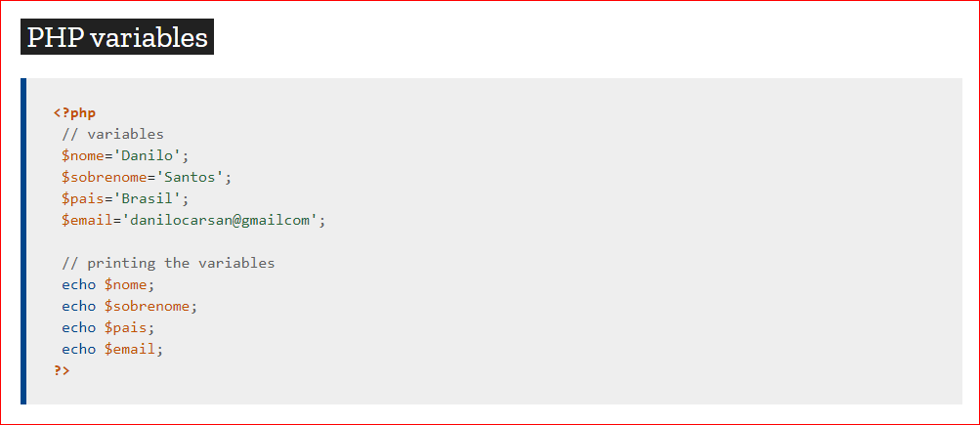

Slide 9
After PHP
OOPs(Object oriented Programming) PHP
3layer architecture
PDO (PHP data types) database connection
Laravel

